Slide 1
A Level Sociology
An Introduction

Slide 2

Introductory Quiz
Have a go
All of the questions come up at some point over the two years of the A Level

Slide 3

1. What is the current population of the United Kingdom?
Source:
Worldometers

Slide 4

2. What percentages of marriages end in divorce in the UK?
42%, down from 45% in 2005
Source:
ONS

Slide 5
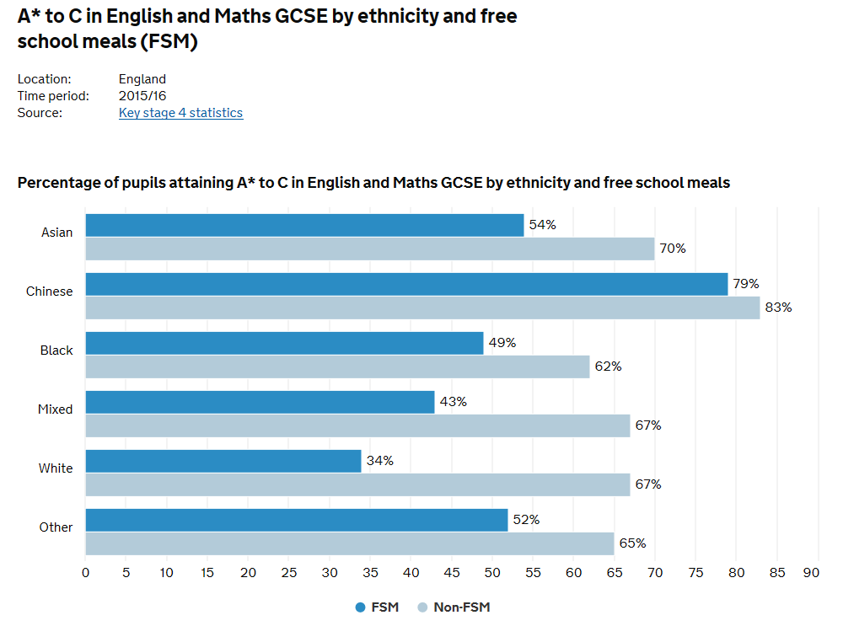
3. What percentage of children achieved 5 GCSEs grades A-C last year?
In 2017, ,the proportion of entries getting A*-C or 9-4 was 66.9%
Figures vary greatly by ethnicity and FSM status:
Source:
Gov.UK

Slide 6
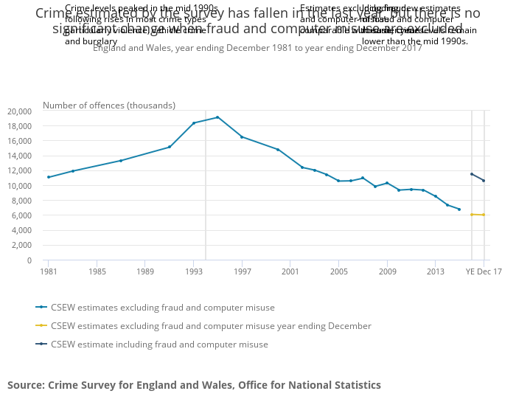
Is the crime rate in Britain going up or down?
Source:
Home Office

Slide 7
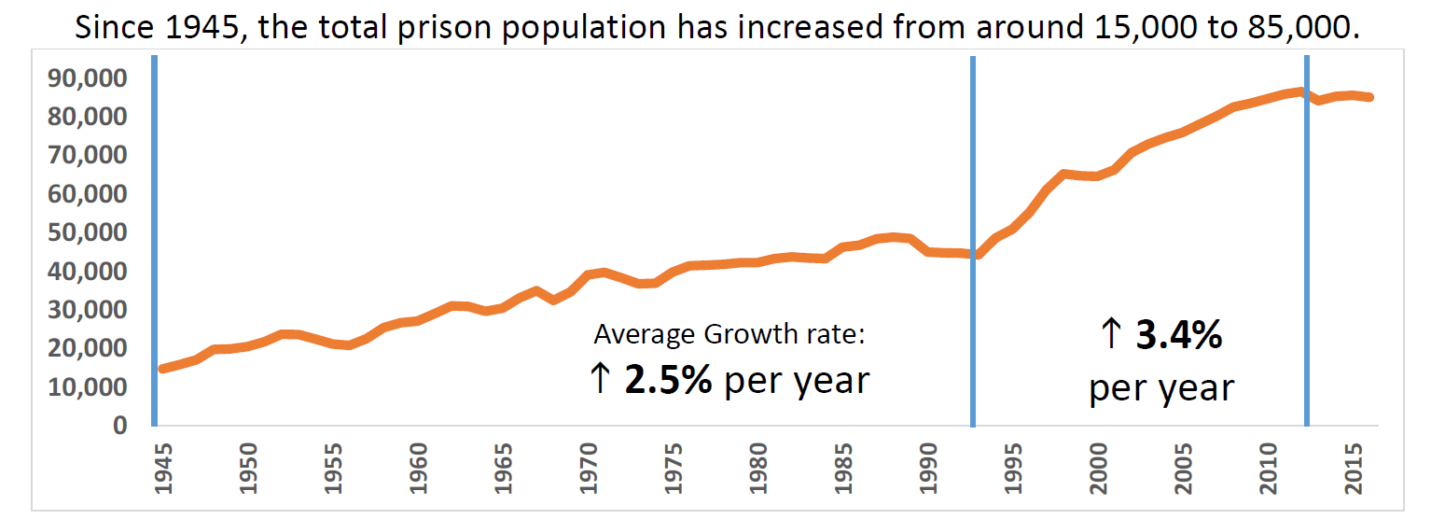
5. In 1993 there were roughly 45 000 people in jail, what is the prison population today?
Source: Ministry of Justice

Slide 8
Intro Quiz Answers
The United Nations estimates that just under 800 million are currently suffering from chronic undernourishment.
In 2016, 650 million were obese.
$150 billion, or more than 10 times less military spending.

Slide 9

A Level Sociology Course Content
We study six sub-topics
Year One
  Families and Households
  Research Methods
  Education
Year Two
  Crime and Deviance
  Theory and Methods
  Global Development

Slide 10

First Year A Level Sociology:
Families and Households
Key Questions:
How has the family changed over the last hundred years?
Why is there such a high rate of family breakdown?
Are men and women equal in relationships?
Are children too controlled by their parents?

Slide 11
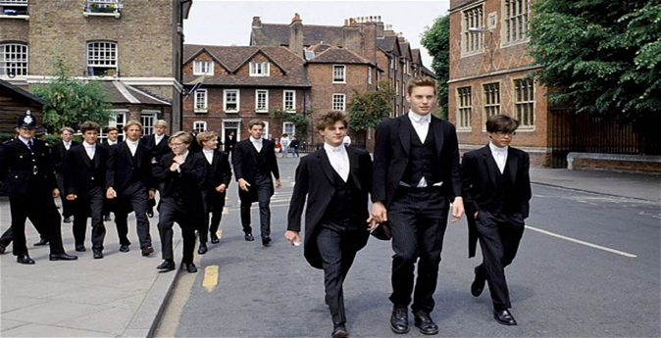
First Year A Level Sociology:
Education with Research Methods
Key Questions:
What is the real purpose of education?
Is it about educating you and getting you ready for work
Or is it really about controlling you?
Why do different groups achieve differently and experience school differently?

Slide 12
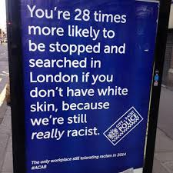
Second Year A Level Sociology:
Crime and Deviance
Key Questions:
Who commits crime?
What are the causes of crime?
Why are some harmful acts regarded as criminal and others not?
What is the most effective way of punishing criminals?
Is policing and punishment fair?

Slide 13

Second Year A Level Sociology:
Global Development
Key Questions:
Why are almost one billion people in the world malnourished when there is enough food to go around?
Are the rich rich because the poor are poor?
Why is there so much conflict in the world?
Can we avert environmental catastrophe?
We also look at globalisation and how this increasingly effects our day to day lives.

Slide 14
Skills Needed for Sociology
Sociology is 100% exam based, no coursework
You need to be able to write essays.
You will be required to write one two page essay per week – minimum
You need to be able to use evidence to assess theories. You need to be able to think for yourself.
You should be doing at least one other serious A level subject – either essay based or maths/ science.
Good combination subjects include
English, History, Politics, Philosophy, Economics
Psychology, Maths, and any science

Slide 15
Questions About Questions
How do you know how many people there are in the UK, and globally?
Sociology tells us we need to be sceptical about population figures, especially in developing countries, and where immigration is concerned.
Suggest one way in which the declining crime rate might be related to the increasing prison population
Sociology shows us that putting more people in jail doesn’t necessarily reduce crime rates, there are other underlying factors which explain the declining crime rate.
Why does the world spend so much on war and so little on development aid?
Obviously too big a question to answer here… Sociology focuses on global problems

